Slide 1
SUPERSTORE SALES ANALYSIS
Painam Susmitha
MIS Executive

Slide 2
Project Objective
Analyze sales data to understand business performance
Identify top-performing regions, products, and customers
Track monthly sales trends
Support business decision-making using data insights

Slide 3
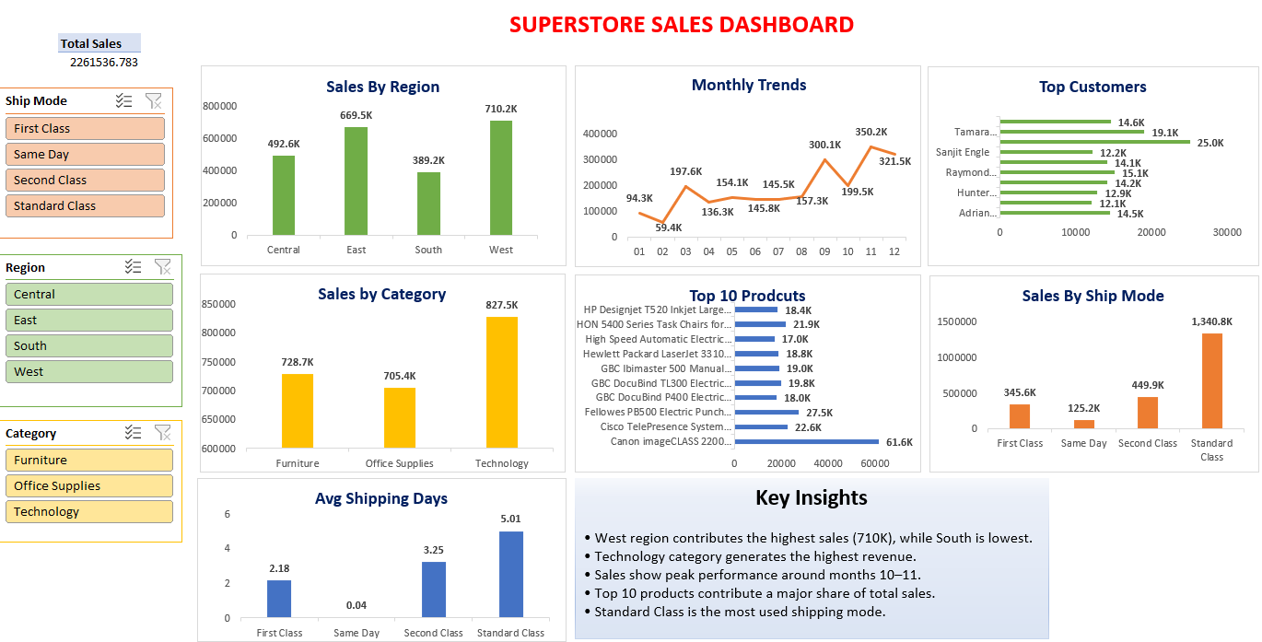
Dashboard
Interactive dashboard created using Excel Pivot Tables, charts, and slicers to analyze sales performance.

Slide 4
Key Insights
West region contributes the highest sales (~710K), while South has the lowest
Technology category generates the highest revenue among all categories
Sales show fluctuations but peak around months 10–11
Top products and customers contribute a significant portion of total sales
Standard Class shipping is most commonly used by customers

